Slide 1
Lab 9 BUCKET, RADIX SORT & BINARY TREES
CSC-221
Engr. Ayesha Khan
Data Structure and Algorithms

Slide 2
Bucket Sort
Bucket sort, or bin sort, is a sorting algorithm that works by distributing the elements of an array into a number of buckets. Each bucket is then sorted individually, either using a different sorting algorithm, or by recursively applying the bucket sorting algorithm.

Slide 3
Bucket Algorithm
bucketSort(arr[], n)
1) Create n empty buckets (Or lists).
2) Do following for every array element arr[i].
.......a) Insert arr[i] into bucket[n*array[i]]
3) Sort individual buckets using insertion sort.
4) Concatenate all sorted buckets.

Slide 4
Radix Sort
The idea of Radix Sort is to do digit by digit sort starting from least significant digit to most significant digit. Radix sort uses counting sort as a subroutine to sort.
Algorithm
https://www.geeksforgeeks.org/radix-sort/

Slide 5
Binary trees
A binary tree is a special type of tree in which every node or vertex has either no child node or one child node or two child nodes. A binary tree is an important class of a tree data structure in which a node can have at most two children.
Child node in a binary tree on the left is termed as 'left child node' and node in the right is termed as the 'right child node.'

Slide 6
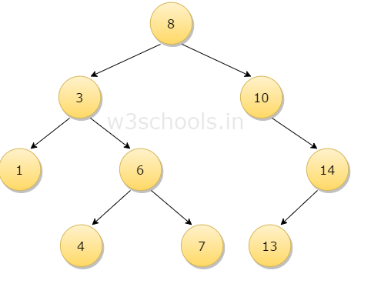
Binary trees
In the figure mentioned below, the root node 8 has two children 3 and 10; then this two child node again acts as a parent node for 1 and 6 for left parent node 3 and 14 for right parent node 10. Similarly, 6 and 14 has a child node.

Slide 7
Implementation of binary trees
There are two ways to represent binary trees. These are:
Using arrays
Using Linked lists

Slide 8
Static Binary Tree Using Arrays
If Root index=p; then left_child=(2*p)+1; and right_child=(2*p)+2;

Slide 9
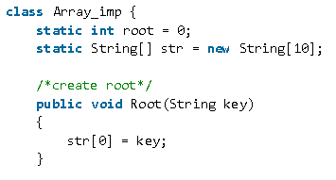
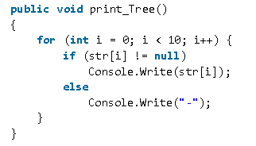
Array Implementation Class

Slide 10
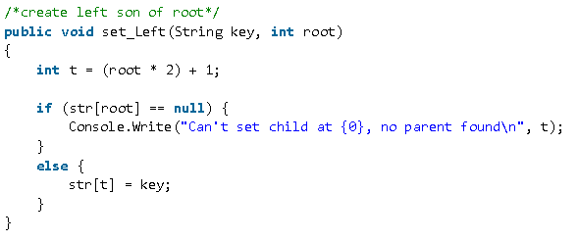
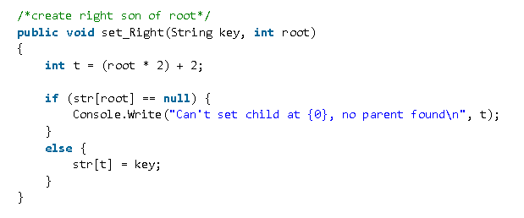
Array Implementation Class

Slide 11
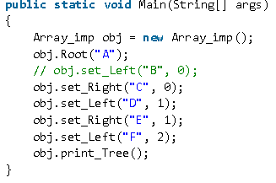
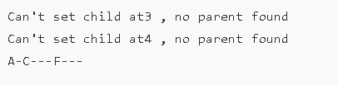
Main method and output

Slide 12
Pre order traversal
In pre-order traversal, each node is processed before (pre) either of its sub-trees. This is the simplest traversal to understand. However, even though each node is processed before the sub-trees, it still requires that some information must be maintained while moving down the tree. Let us consider an example

Slide 13
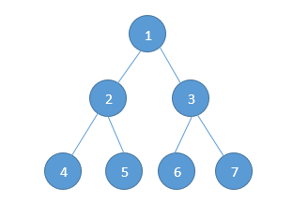
Pre order traversal
Pre-order traversal is defined as follows:
Visit the root (Step 1)
Traverse the left sub-tree in Pre-order (Step 2)
Traverse the right sub-tree in Pre-order (Step 3)
With this definition, let us try to traverse the above tree –

Slide 14
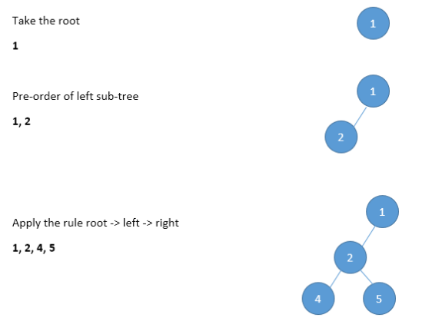
Pre order traversal

Slide 15
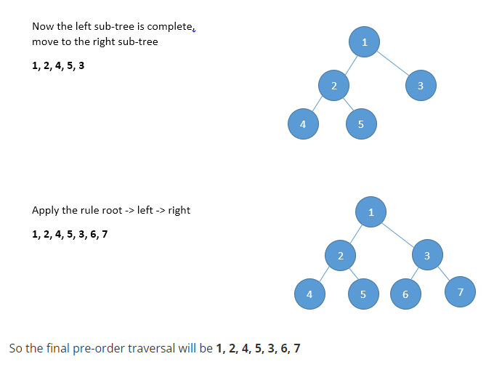
Pre order traversal

Slide 16
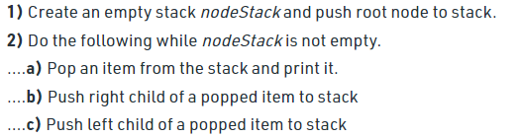

Slide 17
Post order
In Post-Order traversal, the root is visited after both sub-trees are completed. Post-order traversal is defined as follows:-
Traverse the left sub-tree in post-order. (Step 1)
Traverse the right sub-tree in post-order. (Step 2)
Visit the root

Slide 18
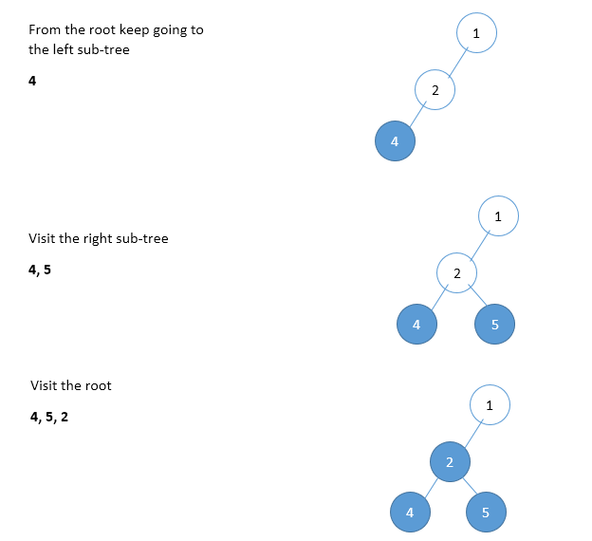

Slide 19
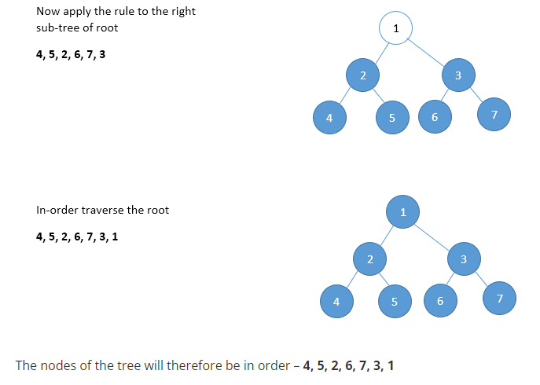

Slide 20
Lab Tasks
1.Implement bucket sort using linked list.
2. Create static tree and perform inorder, preorder and post order traversal. Also search a required node in the tree.

Slide 21
Thank You

